Slide 1

RIDOPSY Locate anyone, Track anything, Schedule anyway, Godlike
Sri Manakula Vinayagar Engineering College
Shyam Suganth J
Thamarai Selvan S

Slide 2
Peek Into
A Preview
What is Ridopsy?
Ridopsy services
Backend processing
Exploding applications
Ridopsy construction
Ridopsy - Everywhere, Everything

Slide 3
A Preview
Time is precise and valuable. The practice of calling someone to know where he is and when he would reach is now over.
Information gathering about transport location and travel is tedious.
Ridopsy is an android mobile application that serves to pinpoint any identity in a Google map, its status, route, distance from you and the time to hit you.
Ridopsy is all about easing the way of locating, tracking, monitoring, analyzing, scheduling and lifestyle upgrading.

Slide 4
What Is Ridopsy?
As a one liner: Ridopsy is an app which conveys the user with extreme precision about the current location of a transport, person or a service.
For example it simply tells the user where his pick up ride is currently moving, how long it would take to reach his pick up point, how far away it is located, and even at which minute he should start off to his pick up point, to board it.
Ridopsy includes two diverse usages. You may login as a rider constantly updating the lat long positions in the cloud or sit at home and watch the units moving in the map, and finding the closest ride available.

Slide 5





Ridopsy Services
Pinpoints all available transport vehicles (your pickup as a bus) in the Google map and identifies the nearest vehicle from your stop, informs you about its distance and duration from the stop. It alerts the user exactly when he should start moving to board his ride.
As a rider you simply turn on your app and drive, automatically updating your lat long position. And as a user you track your friends , find who is nearest to you, watch their movement and contact them.
Any unengaged ambulance all around you are tracked and the user contacts the driver who is nearest for emergency services.
The user can check for all available mobile ATMs, find the nearest one’s location, distance and duration to reach it in the map.
Any registered cab is identified by a user of specific location where he calls the nearest cab driver, watching his duration to reach in the map, taxi model and seat availability.

Slide 6
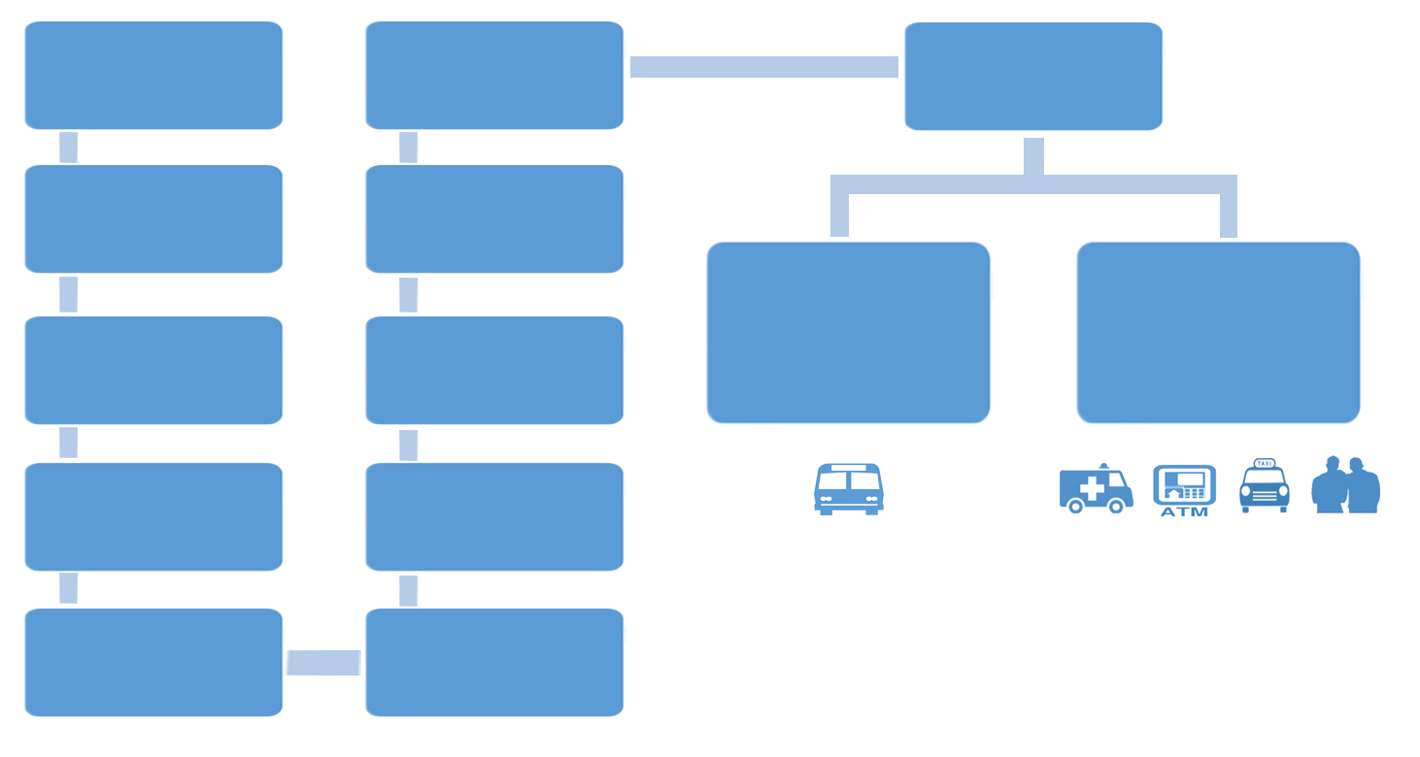
Backend Processing
Rider Login
Monitors all riders
Location, distance
Select the nearest rider
Turn on transmission
Track the rider with LatLong
Gets reminder to start off as the rider closest to pickup point
(Time scheduling)
Contact / reach nearest rider
Constant download from cloud
Starts riding
Rider LatLong
(Using GPS)
Select type of service
Constant update in cloud
User login

Slide 7
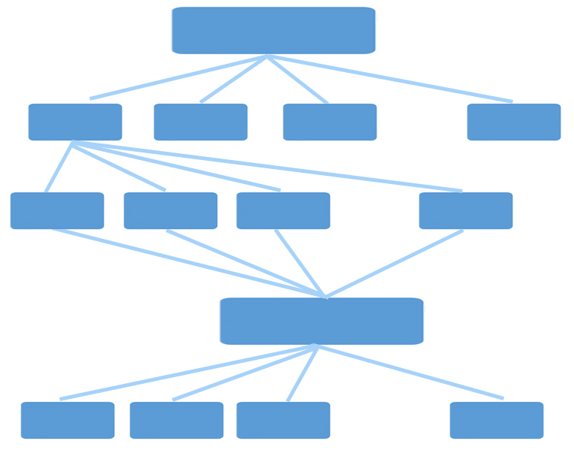
Architecture
Ridopsy Application
Service 1
Service 2
Service 3
Service n
Rider 1
Rider 2
Rider 3
Rider n
Rider
Cloud Database
User 1
User 2
User 3
User n

Slide 8
Exploding Applications
Ridopsy is an ultimate transport tracker which is very user friendly that it makes the lifestyle of the user easier.
Ridopsy eliminates the manual searching of a transport in person , and simply notifies the user of all available units and services in and far away from his locality.
Rider location precision is extreme and constant movement monitoring is possible.
Ridopsy enables any person to board his pickup in time, notifies the nearest pickup, its location, distance, time to reach it and other details.
The emergency services as Ambulance and mobile ATMs are life saving and easily available.
Personal friends are tracked of their locations and can be easily contacted.
Cab services provide quick cab bookings for the nearest available unit.

Slide 9

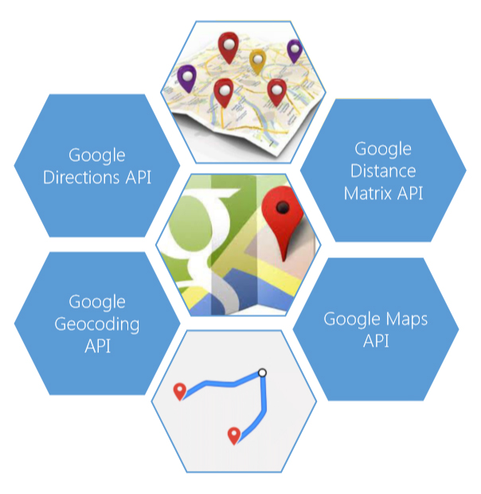
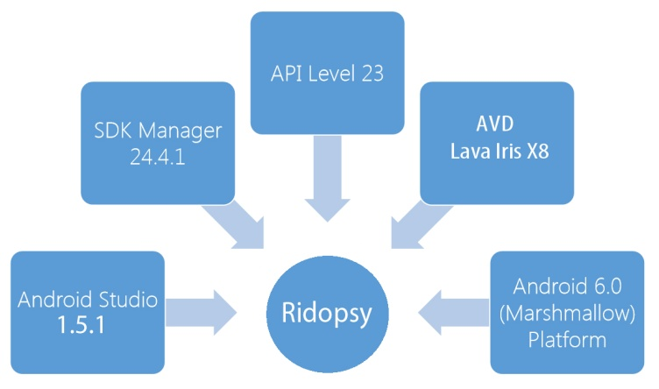
Ridopsy Construction
Service Used
API’s Used
Tool’s Used

Slide 10
Ridopsy- Everywhere, Everything
Ridopsy assists every common person or a child in scheduling his time.
Any individual or an organization can make use of it to identify the client’s(rider’s) location, movement and other details.
It eliminates the traditional concept of manual information gathering of a unit’s location, arrival, movement etc.
Ridopsy integrates many services in which the user can utilize the services available near him.
In short Ridopsy is for everyone used everywhere and provide services for everything.

